Slide 1
Tableau - Data Visualization for Business Analytics
File created on: 5/27/24 5:55:58 PM CDT

Slide 2
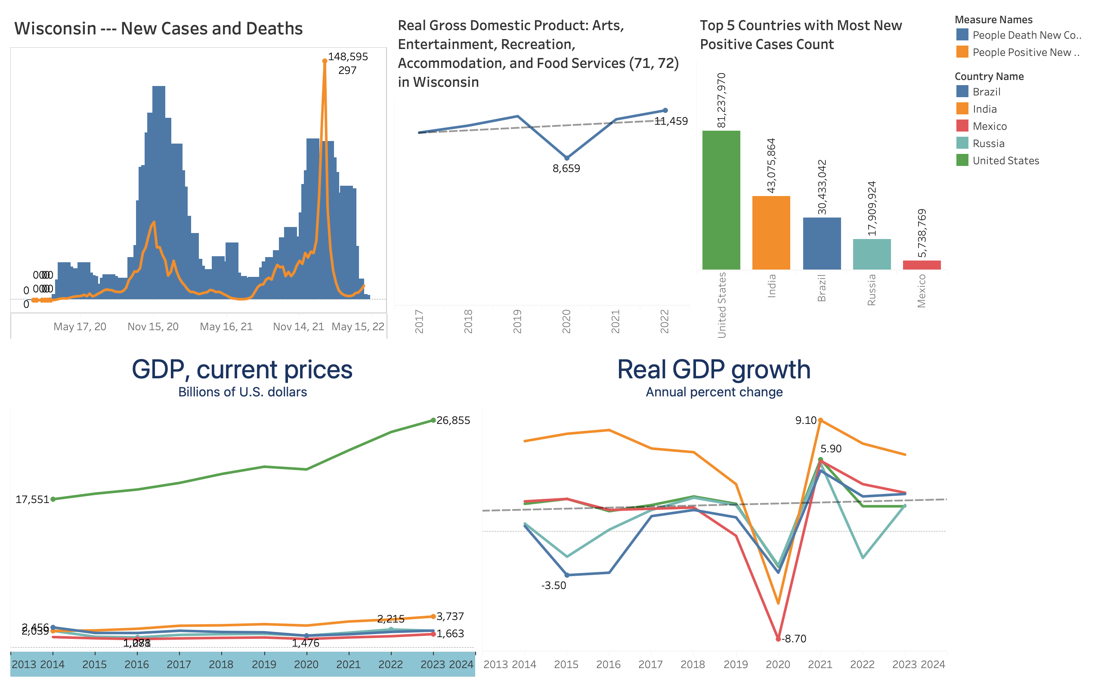

Slide 3
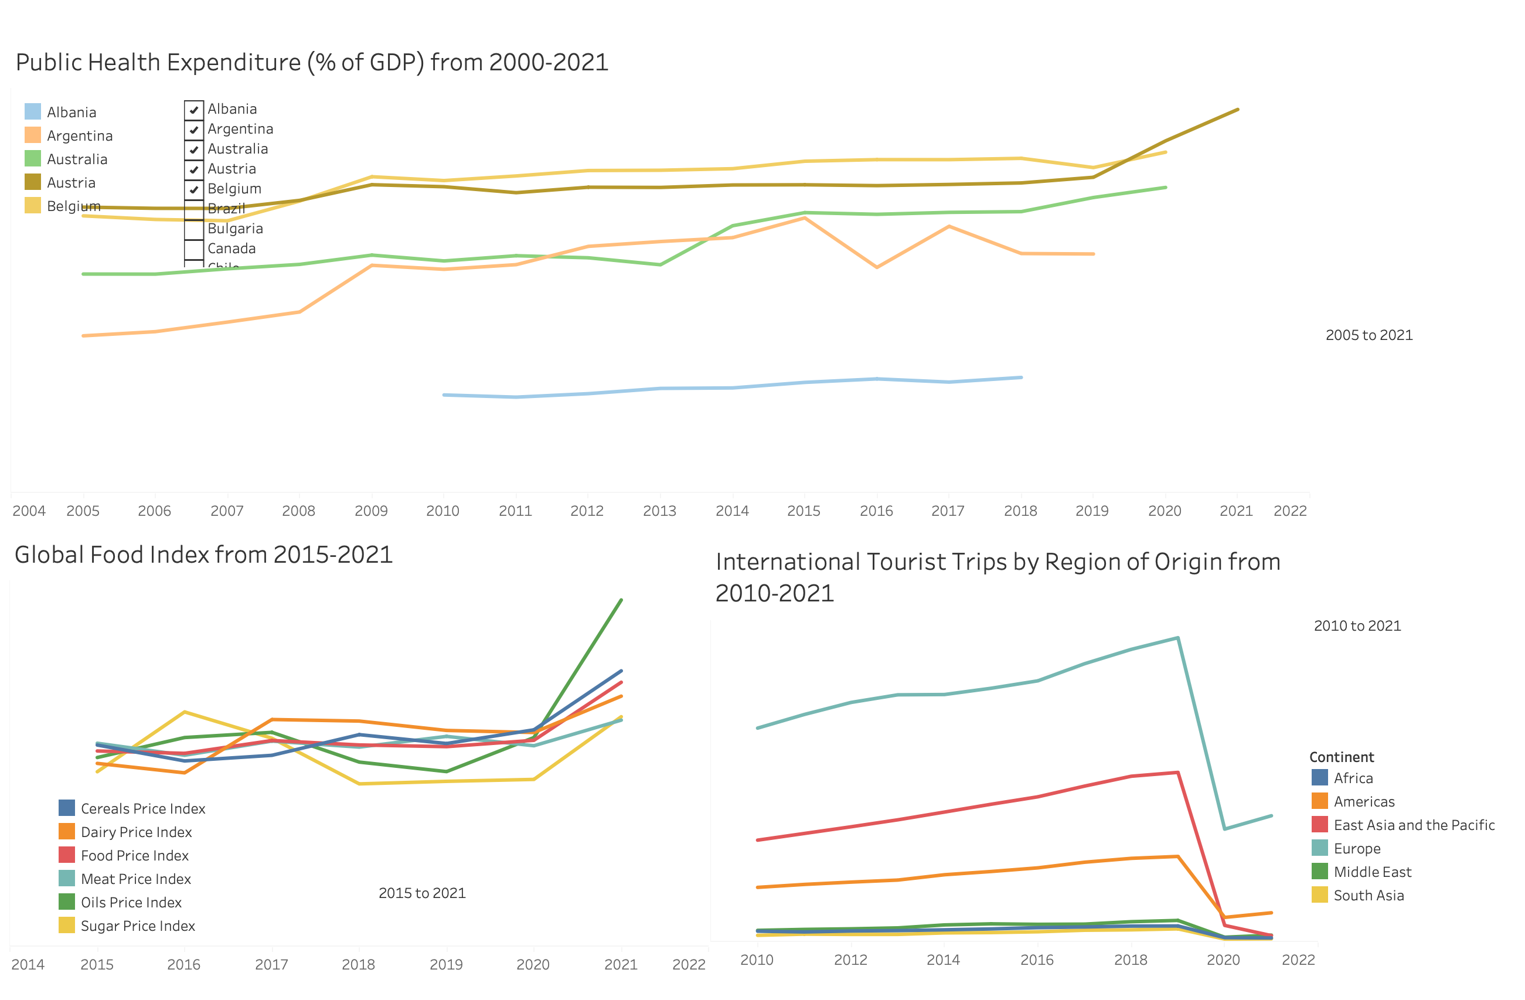

Slide 4
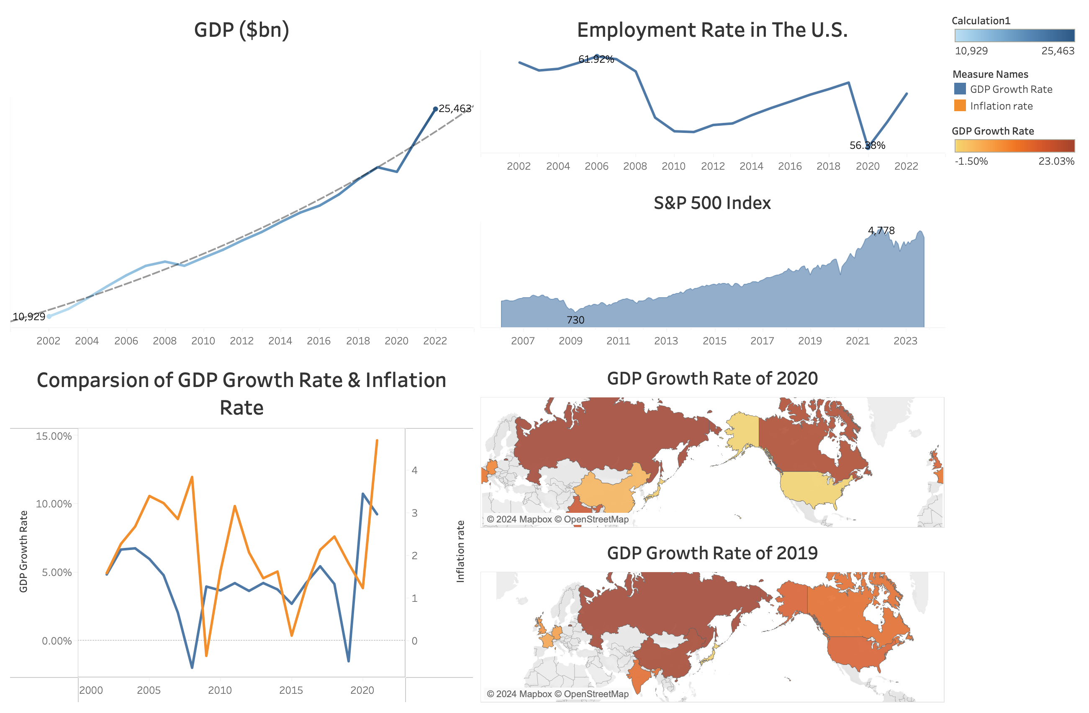

Slide 5
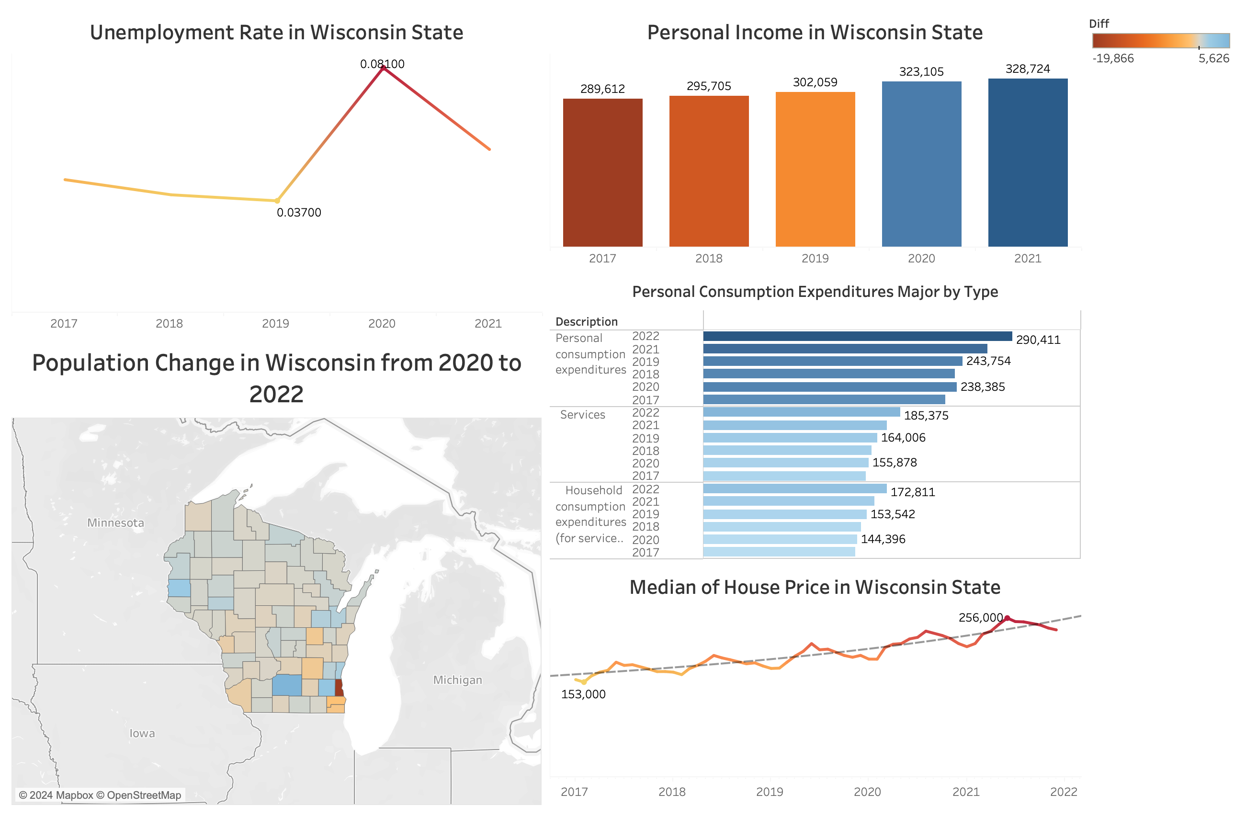

Slide 6
